Slide 1
Education Stability for Foster Youth

Slide 2
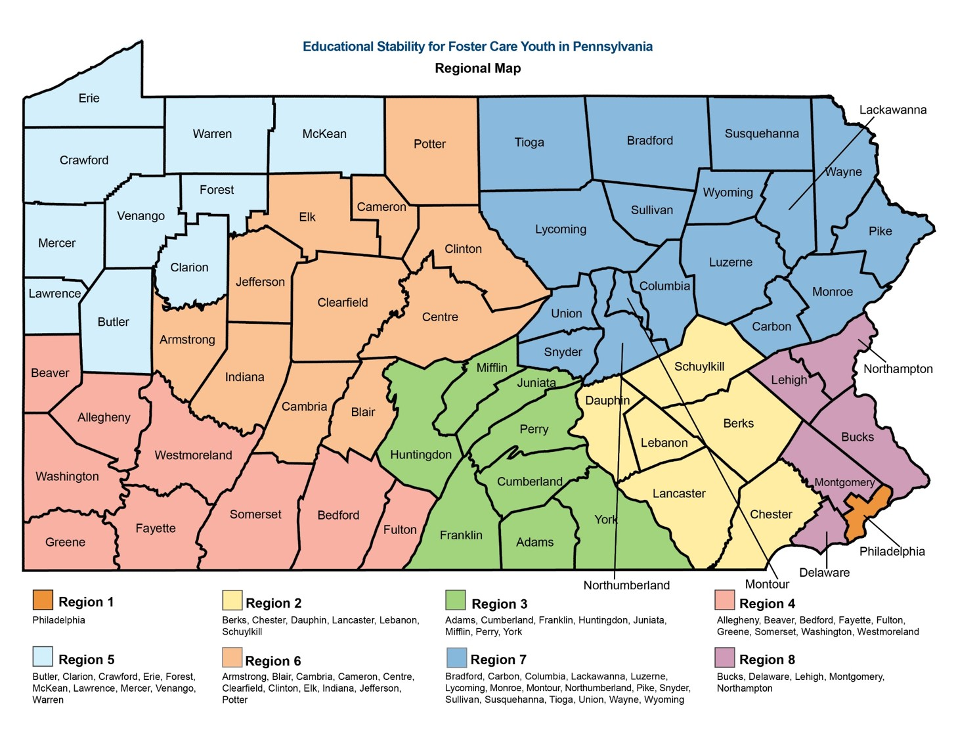

Slide 3
Foster Care Statistics
443, 000 students place nationally (2017)
690,000 children spent time in foster care (2017, US Dept. of Health and Human Services)
16,423 foster students in PA
61% placed due to neglect
32% placed due to drug abuse

Slide 4
Foster Care Statistics
56% of foster children were between 6 and 18 years old (2017)
64% have been in more than one placement (2017)
20% of foster youth enroll in college
60% of population enroll in college
Less than 10% earn a bachelor’s degree (24% of general population)

Slide 5
Challenges for Foster Youth
Lack of nurturing and stable environment
High rates of physical, mental and developmental problems
Unmet needs
Adverse childhood experiences
Dependent on positive school and child welfare supports

Slide 6
Challenges for Foster Youth in Education
Repeating classes, grades (not enough credits)
Losing relationships with teachers, friends and staff
Adapting to different teaching styles (due to frequent school changes)

Slide 7
Legislation
Fostering Connections Act (2008)
-Applied to welfare agencies
-Goal was educational stability
Uninterrupted Scholars Act (2013)
-Allows sharing of educational records between school and welfare agency
Every Student Succeeds Act (ESSA) (2015)
-Mandates school districts, embeds protections for foster youth in federal law
-Includes foster care provisions that mirror or complement the 2008
Fostering Connections Act
-Effective December 10, 2016

Slide 8
Definition
24-hour substitute care away from parent/guardian
Place in out of home placement
Child welfare agency has placement and/or care responsibility
Typically, placed under order of court

Slide 9
Foster Placements (includes 1305 and 1306 settings)
Foster family homeless or resource families
Foster homes of relatives (formal kinship care)
Group homes
Emergency shelters
Residential treatment facilities (RTFs)
Child care institutions
Independent living settings
Pre-adoptive homes

Slide 10
ESSA Foster Provisions
ESSA presumes a child will remain in their school of origin unless it is not in their best interest
Must ensure collaboration and consideration of best interest
Best Interest Determinations (BIDs) are a dual-agency responsibility (LEA of origin and CCYA)
If school district placement is impacted, a BID must occur
All LEAs must establish a point of contact (POC)
LEAs must have an MOU and Transportation Plan with local CCYA

Slide 11
ESSA
Collaboration
Best Interest Determination
Transportation
Immediate Enrollment and Records Transfer

Slide 12
Best Interest Determination (BID)
Transportation, tuition or special education cost cannot be determining factors
BID must be documented by school of origin
Best interest can change, however, protections are applicable for duration of time in foster care
Child cannot be withheld from attending school during interim or dispute
Local BID process and transportation plan must address dispute procedures
Proximity of placement and educational setting should be considered during process

Slide 13
BID Participants
LEA of origin and CCYA must participate in BID
Strongly encouraged to include LEA of foster residence
Additional parties can possibly be:
-IEP Team -Child advocate
-Special Education Coordinator -Guardian ad litem
-Case Worker -Mental/Behavioral Health providers
-Case Manager -Foster parent
-Coaches -Teachers

Slide 14
Guidelines for BID Process
Local procedures should establish:
Who initiates the BID process
Who participates
Format of BID and how BID is documented
Local procedures should consider:
Appropriateness of current educational placement
Proximity of placement
Other child centered factors
How child will remain in school of origin during the interim of a final determination

Slide 15
Factors to Consider (BIDs)
Preferences of child
Distance of commute to school of origin
Child’s permanency goal
Length of stay at school of origin
Safety considerations
Special education program

Slide 16
Factors to Consider (BIDs) cont’d.
Academic history
Transferring have a positive or negative impact socially, emotionally and academically
Peer/staff relationships
Will new school allow student to stay on track to graduate?
Timing of transfer will not undermine school success
Siblings
Extra-curricular activities/interests

Slide 17
Transportation
Transportation must be provided, arranged and funded
No distance specified
LEAs must maintain a transportation plan and Memorandum of Understanding (MOU) with CCYA
LEAs should consider CCYAs they work with frequently
LEAs must ensure transportation is provided to children in foster care even if an LEA does not normally offer and/or provide transportation

Slide 18
Memorandum of Understanding (MOU)
Addresses transportation related provisions
Not a local transportation plan
Agreement with LEA and CCYA to establish a local transportation plan
Additional policies may be addresses to meet unique needs of foster children

Slide 19
Transportation Plans
Addresses formal, written protocols and procedures
Ensures foster children remain in school of origin when feasible and in his/her best interest
Detailed step-by-step arrangements
Limit educational disruption
Who will provide transportation

Slide 20
Transportation Plans cont’d.
Consider low cost options
How will additional costs be covered
Transportation Plan and MOU must be signed by LEA and CCYA
MOUs and plans should be updated as needed

Slide 21
Immediate Enrollment
Foster youth must be immediately enrolled into new school
Must be enrolled even if they lack records normally required for enrollment
Contact prior school for records
Prior school should anticipate this request as a result of a BID
Placing CCYA should assist as needed and in accordance with confidentiality laws
30 days for immunization records
Foster students eligible for free lunch

Slide 22
Foster Point of Contact (POC) Duties
Coordinate with CCYA (primary contact for agency)
Coordinate with other LEAs
Collecting and presenting all important records and documentation
Attending training and professional development
Develop BID process
Facilitate transfer of records

Slide 23
Foster Point of Contact (POC) Duties cont’d.
Facilitate immediate enrollment
Facilitate data sharing with the child welfare agencies, consistent with FERPA and other privacy protocols
Developing and coordinating transportation procedures
Managing BIDs and disputes
Ensuring attendance/needs of foster students
Providing professional development
Ensure communication and collaboration with regional office

Slide 24
Educational Goals
Balance
Security
Strength
Support
Connectedness
Dependability
Steadiness
Structure
Permanence

Slide 25
Questions???

Slide 26
Contact Information
Jeff Zimmerman
jzimmerman@liu18.org
570-718-4613 or
Andy Kuhl
akuhl@liu18.org
570-718-4697
http://www.liu18.org/index.php/esfcy

