Slide 1

Preventing Suicide is
Everybody’s Business
Expanded Training

Slide 2

Dedication
To those who have lost their lives by suicide,
To those that struggle with thoughts of suicide,
To those who have made an attempt on their lives,
To those caring for someone that struggles,
To those left behind after a death by suicide,
To those in recovery, and
To all those who work tirelessly to prevent suicide and suicide attempts in our nation.
2012 National Strategy for Suicide Prevention

Slide 3
The deaths rates for 8 of the 10 leading causes of death have decreased significantly………
But not for the 10th leading cause-suicide.
Some tragedies such as suicides happen rarely, but have extremely serious consequences. Especially Youth Suicides.

Slide 4
Public Health Problem
Suicide is COMPLEX.
It is most often the outcome of "MULTIPLE” factors.
While it may appear “SUDDEN” to others, most often "
there are underlying factors, some long-standing; "
These factors may be genetic, familial, environmental or experiential. "
They may be unrecognized, or untreated or undertreated, ……
- WellAware

Slide 5
Nationally:
Suicide prevention efforts have been focused mostly on youths and older adults, but recent evidence suggests that suicide rates among middle-aged adults in the United States have increased substantially.
Firearms, suffocation (predominantly hanging), and poisoning (predominantly drug overdose) are the three leading mechanisms of suicide.
Suicide is the 10th leading cause of death, claiming twice as many lives each year as homicide.
1 person dies by suicide every 15 minutes. Estimated 105 115
people die by suicide every day.
Almost 16% of students grades 9 to 12 report having seriously considered suicide.

Slide 6
Language is Important
Suicide - A self-inflicted death for which there is evidence of intent to die.
Suicidal Ideation - Thoughts in which self-inflicted death is a desired outcome, and which may or may not include a plan, but does involve an explicit attempt.
Nonsuicidal Self-Injury - A self-inflicted, potentially injurious behavior for which there is evidence that the person did not intend to kill him/herself (that is no intent to die).
Please say that an individual has died by suicide – not committed suicide.

Slide 7
Components of the School Role
PA Act 71 mandates 4 hours every 5 years of training on suicide prevention for school educators in grades 6-12.
Schools need protocols for helping students who may be at risk for suicide.
Schools need protocols/ a crisis plan, for responding to a suicide death (Postvention)
Ideally, schools will include education for students (kids tell kids) as well as a parent education program.

Slide 8
Reasons School Should Address Suicide
Maintaining a safe school environment is part of a schools overall mission.
Student’s mental health can affect their academic performance.
One student can significantly impact the entire school community.
Schools have been sued for negligence for failing to notify parents if their was signs of risk, failure to get assistance and adequately supervise a student at risk of suicide.

Slide 9
You are all Gatekeepers!

Slide 10
According to the Surgeon General’s National Strategy for Suicide Prevention
A gatekeeper is someone in a position to recognize a crisis and the warning signs that someone may be contemplating suicide.
Gatekeepers include parents, friends, neighbors, teachers, ministers, doctors, nurses, office supervisors, squad leaders, foremen, police officers, advisors, caseworkers, firefighters, and many others who are strategically positioned to recognize and refer someone at risk of suicide.

Slide 11
Who and What are Gatekeepers?
Gatekeepers are individuals who by the nature of their job, or in their personal relationships, are in a position to observe high risk behaviors and take action when necessary. A Gatekeeper refers to someone who:
Knows basic information about suicide and learns basic suicide
intervention skills.
Believes that suicide can be prevented.
Has the confidence to respond.
Can assist in the aftermath of a suicide.

Slide 12
Attitude
You need to come into this training with an understanding that you are not asked to be a therapist!
This training is similar to any training for identifying the signs of a physical illness and asking for help for a child.
Yes, suicide is scary. We are only asking you to do what you would normally want to do anyway, we are just giving you some tools.

Slide 13
FIRST……
Schools should have in place protocols PRIOR to any trainings on how to identify students at risk of suicide. Everyone in the school should know these protocols.
Identifying students who may be at risk of suicide will be more likely to be successful when these procedures are in place, and only after these procedures are in place is a school ready to implement other suicide prevention strategies. LET’S DISCUSS YOUR SCHOOL.

Slide 14
Remember
All staff should have:
Education on the importance of suicide prevention and….
How to recognize suicide risk.
Only selected staff should have training to assess and refer students at risk of suicide to the appropriate services.
You are not alone in this!

Slide 15
SCHOOL TEAM
Guidance Counselor
Parents
Guardians
Mental Health
Provider
Emergency
Services
School Administration
Other

Slide 16
The Intervention Process
Youth suicide prevention in schools includes five major areas of responsibility:
1. Identification;
2. Assessment;
3. Management and Referral;
4. Support Services and Monitoring; and
5. Crisis Intervention and Post-Intervention Planning.

Slide 17

Risk Factors- Protective Factors
But Most Important are Warning Signs
Risk factors are characteristics that make it more likely that an individual will consider, attempt, or die by suicide.
Protective factors are characteristics that make it less likely that individuals will consider, attempt, or die by suicide.
Warning Signs: Behaviors that can be observed (Aggression, Sadness, Drug or Alcohol Abuse) and are more serious than risk.

Slide 18
Risk Factors- Protective Factors
But Most Important are Warning Signs
Risk factors are often confused with warning signs of suicide, and frequently suicide prevention materials mix the two into lists of “what to watch out for.”
Risk factors are characteristics that make it more likely that an individual will consider, attempt, or die by suicide. TOOLKIT pages GO TO pg 33-35
Protective factors are characteristics that make it less likely that individuals will consider, attempt, or die by suicide. Toolkit pages GO TO pg 37-38

Slide 19
Risk Factors
Risk factors are stressful events, situations, or conditions that exist in a person’s life that may increase the likelihood of attempting or dying by suicide. There is no predictive list of a particular set of risk factors that spells imminent danger of suicide. It is important to understand that risk factors DO NOT cause suicide.

Slide 20
Youth Depression
Identified by observing……… Feelings
Sadness and hopelessness lasting more than 2 weeks
Very irritable
Overreacting
Feeling worthless
Anxious
Concerned with physical problems
Fatigued

Slide 21
Youth Depression cont
Noticing……… Changes
Declining performance
Losing interest in things once enjoyed
Experiencing unexplained changes in sleeping or eating patterns
Isolating
Feeling life is too hard to handle
Irritable
Poor concentration
Racing thoughts

Slide 22
Protective Factors
Protective Factors - personal and social resources that promote resiliency and reduce the potential of suicide. Characteristics that make it less likely that individuals will consider, attempt, or die by suicide. Protective factors may be family level (close supportive family), community level (small classrooms, positive supportive teachers), social (youth activities).
Many protective factors can be increased and some risk factors can be decreased.

Slide 23
Protective Factors
Supports - Supportive parents, friends, teachers & other caring adults
Skills to think, communicate, solve problems, manage anger
Purpose & value in life-hope for future
Personal characteristics - good health, positive outlook, healthy choices
Safe Environment – restricted access to lethal means

Slide 24
WARNING SIGNS
Warning signs are indications that someone MAY be in danger of suicide, either immediately or in the future. Toolkit page 41
NEEDS IMMEDIATE RESPONSE
Not in your Toolkit “TRIGGERS”

Slide 25
Triggers - IMPORTANT
If someone has been depressed or thinking about suicide, a trigger can push that person into an suicide attempt or death.
Teachers in schools can be aware of someone who may be feeling bad and/or experienced WHAT THE STUDENT PERCEIVES as a tragic event.

Slide 26
Triggers are stressful events that may bring about suicidal behavior to someone already at risk.
Trigger events could be:
• The break up of a close personal relationship, losing old friends, or interpersonal conflicts
• The death of a close relative or friend, or the suicide of a classmate
• Something "embarrassing" happens
• Loss of self-esteem (e.g., failing at school, being cut from a team) or feeling humiliated
• Failing an important exam at school
• Rejection (e.g., not be accepted to a college or graduate school, etc.)
• Being Bullied
• Facing arrest, or other legal difficult, relapse of substance use after a period of recovery, or
• Facing arrest, trial, prison, or other legal difficulty.

Slide 27
RISK FACTORS ARE NOT WARNING SIGNS
Triggers should be red flags to pay close attention to the students.

Slide 28
Statistics on suicide…not accurate so why do we need them?
It is difficult to compile accurate statistics on suicide, since many deaths that are actually suicides are ruled to be accidental. Overdoses, car accidents are 2 examples.
With a clearer understanding of violent deaths we can guide local decisions about efforts to prevent suicides.
Is there a time of year that show increased deaths, are there specific ages more at risk, or will the means used help focus attention and resources?

Slide 29
YOUTH DATA
National TOOLKIT page 43
Drug and Alcohol Data TOOLKIT page 45
Bullying TOOLKIT page 47-48
Culture TOOLKIT page 50-51

Slide 30
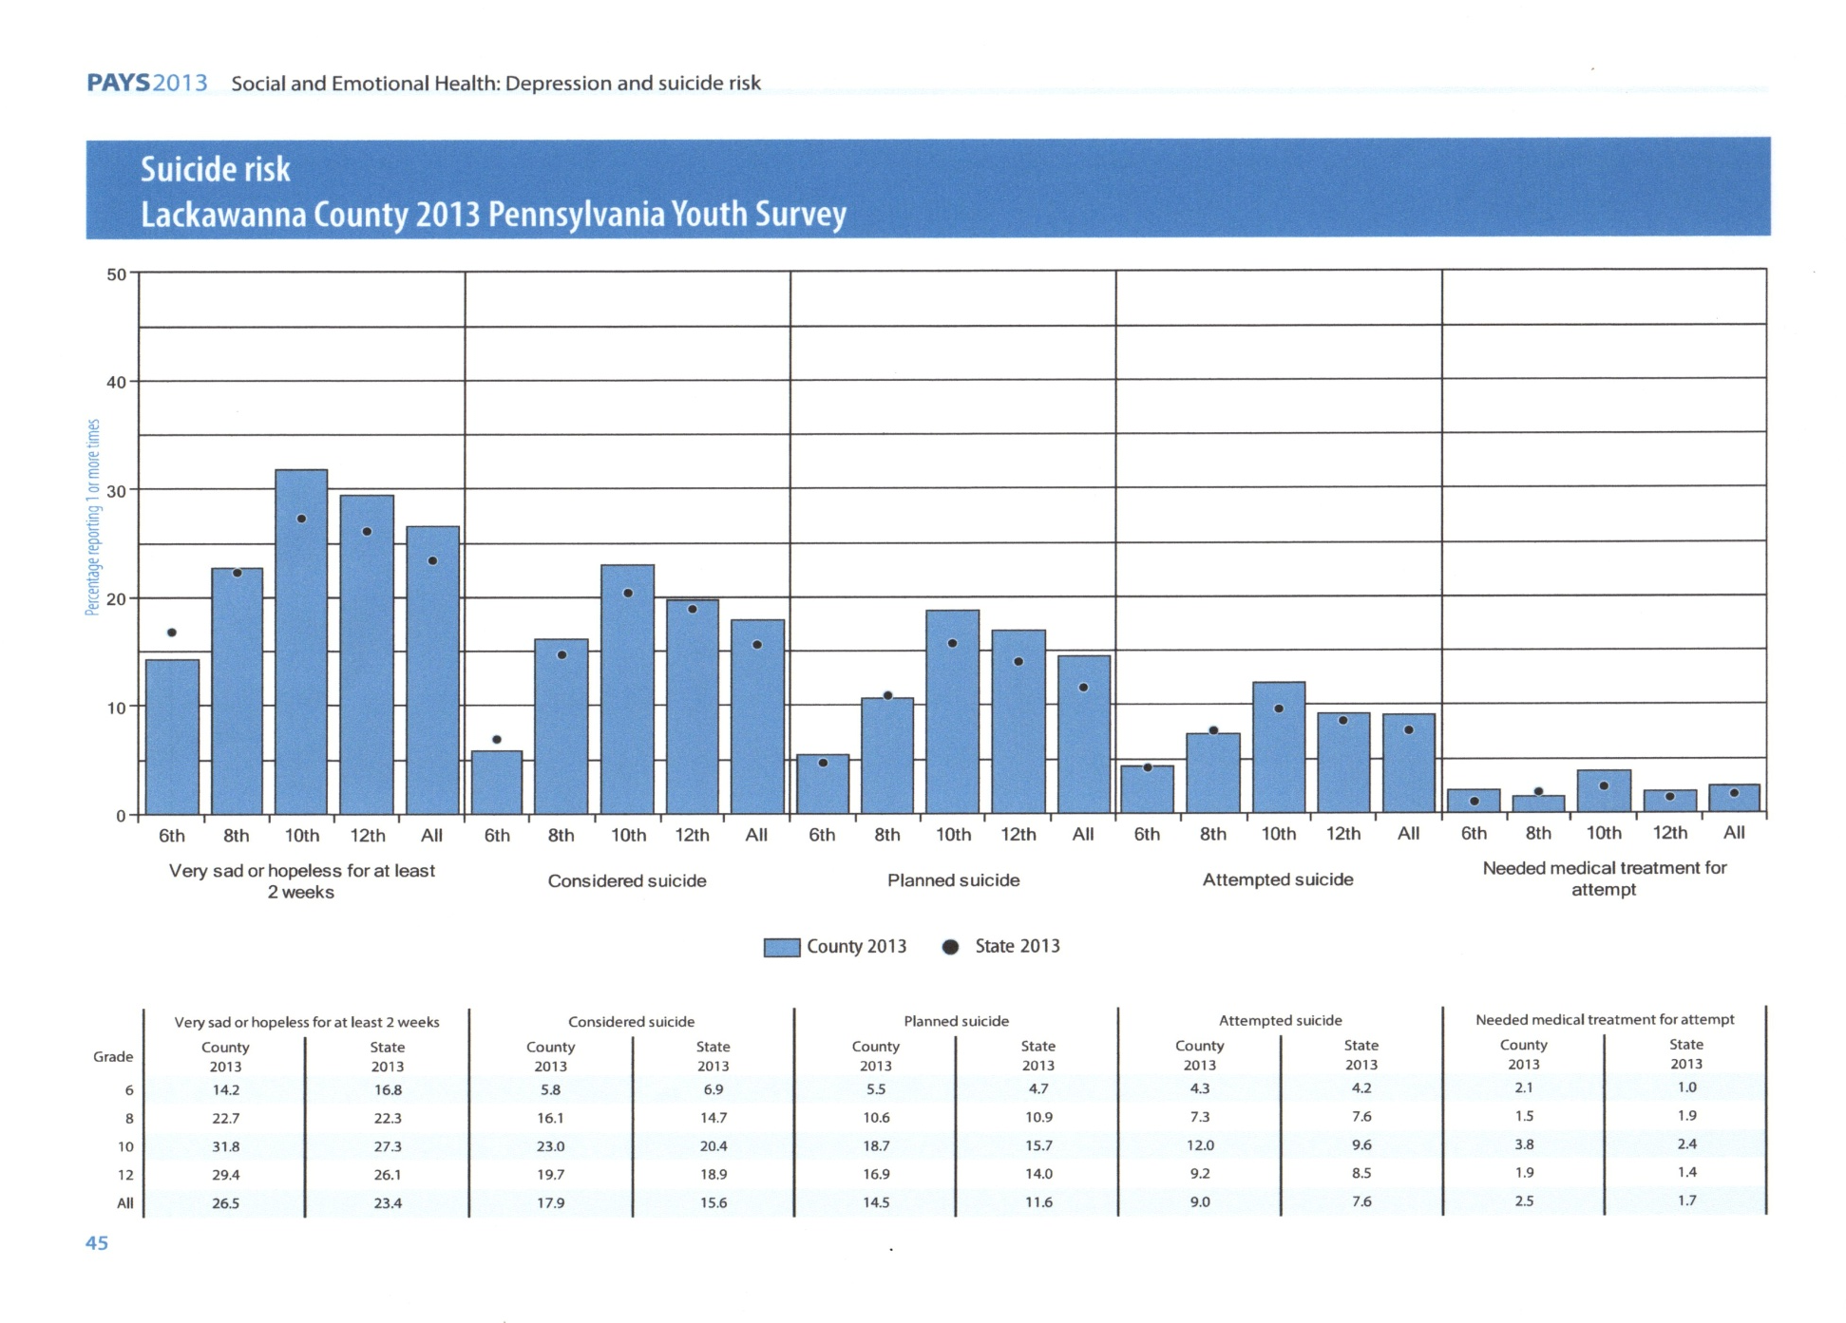
Dots are PA State Averages

Slide 31
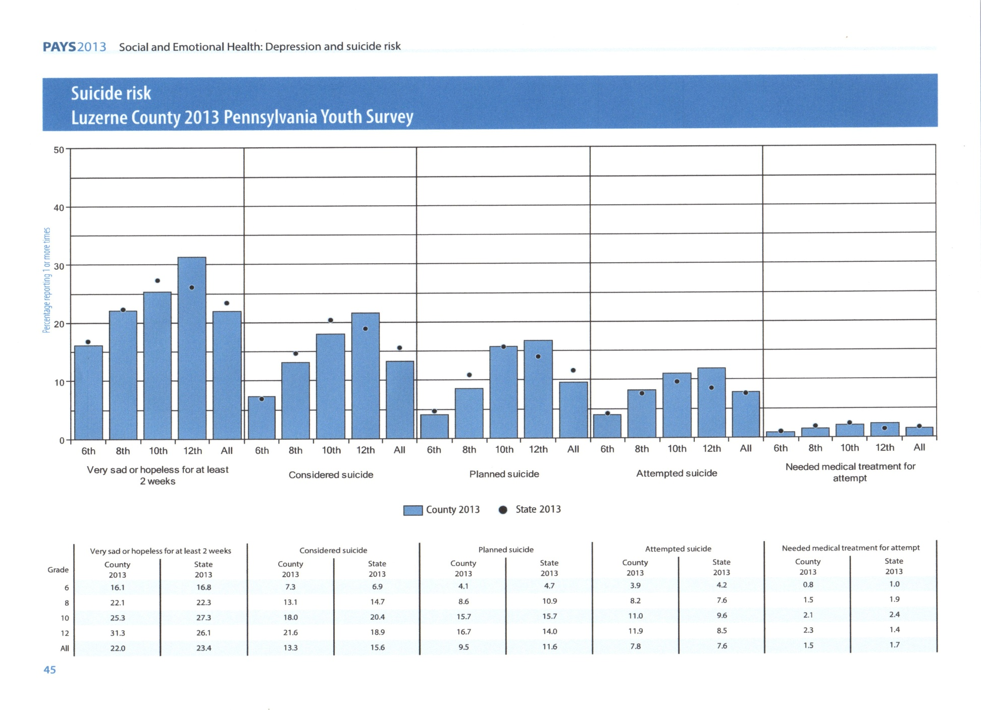

Slide 38
Additional Risk Factors that Can Lead to Suicide
Physical factors - Insomnia and Chronic Pain
Newly diagnosed (age 20) severe mental illness
History of Child Abuse (10-40% of adults who experience suicidal thoughts have a child abuse history)
Psychiatric History
Triggers

Slide 39
What We Know
There is no typical suicide victim.
There are no all inclusive predictive lists of warning signs.
Suicide is always multi dimensional.
Suicidal individuals want to end their pain, but do demonstrate warning signs.
Most suicidal youth confide concerns to peers rather than adults.
As few as 25% of peer confidants tell an adult. (RISK FACTOR)

Slide 40
Suicidal Crisis
Suicidal crises are temporary conditions. An intense suicidal crisis usually lasts 48 hours.
The intensity and urgency associated with suicidal crises tends to disappear or diminish with time.
Suicidal crises can and usually do return like waves.

Slide 41

The Suicidal Process
Suicides often start as occasional thoughts about death and proceed to suicidal ideation, when severe and intrusive thoughts cause a person to dwell on the idea of suicide over a long period of time.
The Suicidal Process happens over time beginning with the first thoughts about suicide, and if not stopped could end in a completed suicide.
The fact that it happens over time for most people means that there is time to intervene successfully.

Slide 42
90% of people who attempt suicide told someone they were having thoughts about suicide.
    Many people give us clues, what we call Invitations to Help by:
    Direct or indirect statements,
    Non-verbal behaviors
    Expressions of hopelessness
    Changes in attitudes and behaviors
These “Invitations to Help” may not always be loud or clear, but the more we know about listening and watching for these Invitations to Help, the better we will be to recognize and respond.

Slide 43
Myths
People who talk about suicide won’t complete it.
Suicide happens without warning.
Suicidal people are intent on dying. On the bridge, Baldwin counted to ten and stayed frozen. He counted to ten again, then vaulted over. “I still see my hands coming off the railing,” he said. As he crossed to chord in flight, Baldwin recalls, “I instantly realized that everything in my life that I’d thought was unfixable was totally fixable – except for having just jumped.” (Friend, T. (2003). Jumpers. The New Yorker.)
Improvement after an attempt means the risk is over.
If you talk to a suicidal person about suicide it will encourage the person to kill themselves.
Self-injury is a strong indicator of suicidal thoughts.
If someone medicates themselves with alcohol, it lessens the stress and the threat of the person acting on it.

Slide 44
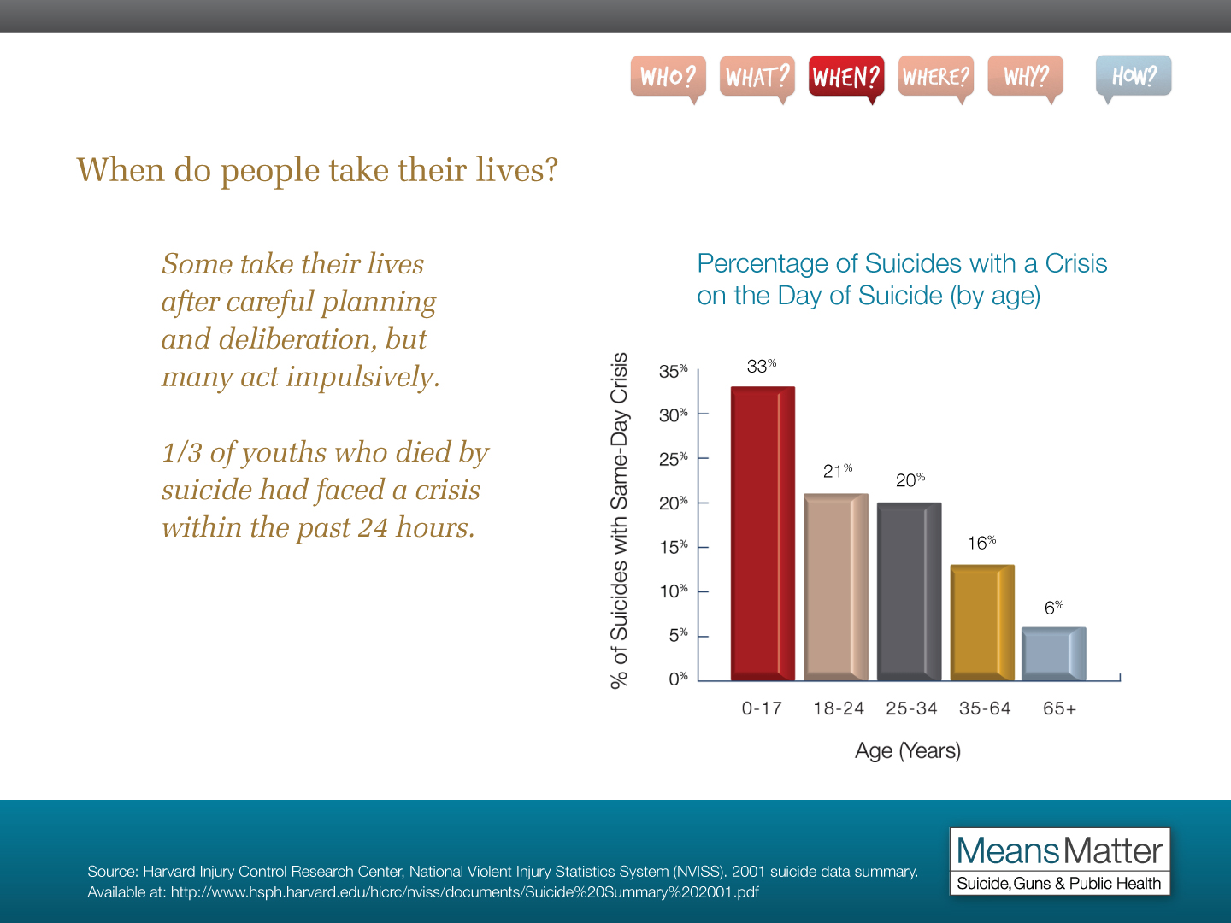

Slide 45


While some suicides are deliberative and involve careful planning, many appear to have an impulsive component and occur during a short-term crisis.
Forty-eight percent of patients treated for a suicide attempt reported that the period between deciding to attempt suicide and the actual attempt was 10 minutes.
Others interviewed reported……
24% said 5-19 minutes
23% said 20 minutes to 1 hour
16% said 2-8 hours
13% said 1 or more days
This is why Means Matter

Slide 46
Substance Abuse & Suicide
Suicide is the leading cause of death among people who abuse alcohol and drugs? (Wilcox, Conner, and Caine 2004)
Individuals who are treated for alcohol abuse or dependence are at about 10 times greater risk to eventually die by suicide compared to the general population, and people who inject drugs are at about 14 Xs greater risk for eventual suicide?
People in treatment are at elevated risk for many reasons, including:
- They enter treatment when they are at a point where their substance abuse is out of control, increasing a variety of risk factors for suicide;
- Mental Health problems(e.g., depression, Post traumatic stress disorder, anxiety disorders, some personality disorders) associated with suicide often co-occur among people who have been treated for substance abuse.
- Crisis that are known to increase suicide risk sometimes occur during treatment (e.g., relapses).

Slide 47

LGBT Issues
Suicide is the 3^{rd,} 2nd leading cause of death among 15 to 24 year olds. Now from 12 years of age to 24!
LGBTQ youth are up to 4x more likely to attempt suicide than their heterosexual peers because of the ways they are treated in their homes, schools, and various communities
Sources: CDC 2007; Massachusetts Youth Risk Behavior Survey 2009
LGB youth who come from highly rejecting families are more than 8 times as likely to have attempted suicide than LGB peers who reported no or low levels of family rejection
More than 75% LGBTQ youth report verbal abuse while 15% report physical abuse at school. More than 1/3 will lose friends through coming out. Increased victimization and losing friends both predict negative mental health outcomes—including substance use and suicide

Slide 48

How Does A Youth Come to Your Attention?
A staff may voice concerns about a change in a youth’s behavior (aggression, isolation, etc.).
A youth(s) may bring concerns to a staff about a youth exhibiting risky behaviors or overhearing statements like, “My family would be better off without me.”
A staff may become aware of a life altering crisis or Trigger for a youth.
A school nurse may bring concerns about a youth’s excessive visitations.
A youth may voice some warning signs during a visit with administration about a discipline problem. Statements like, “I won’t be around much longer to cause anyone trouble.” “I feel like there is no way out of this mess.”
A parent may voice concerns to educational staff about behavior problems.

Slide 49
In a suicidal youth’s mind:
Distress, torment and anxiety are seen as overwhelming
Coping abilities are inadequate
Suicide is seen as a way to end the turmoil
The need to communicate pain is desperate
Unable to think about the irreversibility of suicide or the consequences of death on their friends and family
They believe that their thinking is rational.
Often asking questions allows a suicidal person to let off steam and take steps toward accepting help.
Without intervention, suicide may be seen as the only solution to solving the problems.

Slide 50
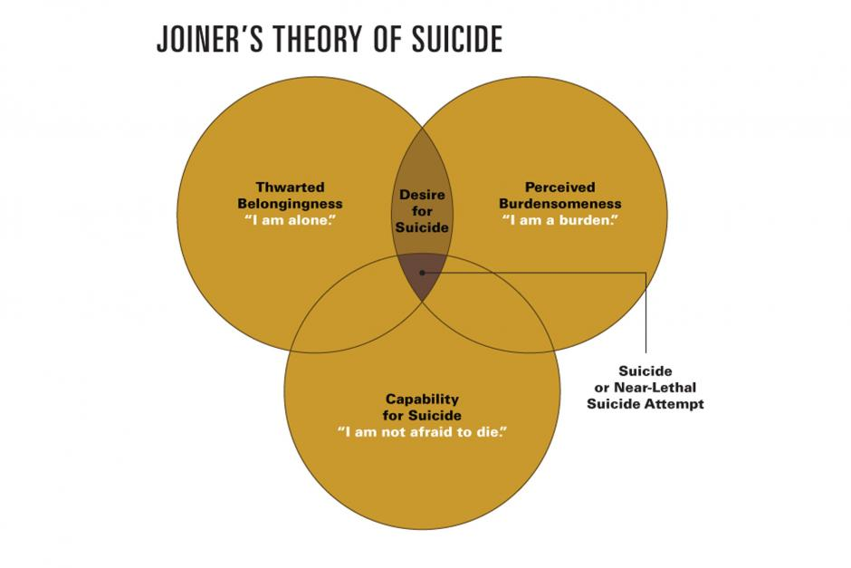

Slide 51
Three Steps to a Basic Suicide Intervention
Ask About Suicide……..Question
Show You Care……… Persuade
Get Help………..............Refer
Direct questions about suicidal thoughts actually lessen the anxiety of the person and decrease suicidal attempts.

Slide 52
Now what do we do?
If you suspect that someone is at risk for suicidal behavior because you have seen some of the warning signs mentioned above, or because the person has confided suicidal thoughts or plans to you…….
Your job is to talk to them and obtain help for them…...
You do not have to conduct a risk assessment or be certain.

Slide 53
Connecting with the Individual
Try to….Stay Calm.
Speak directly to them in a clear and concerned voice. Tell them what has been observed and don’t be hesitant to voice your concerns.
Ex. “I am really concerned about your isolating yourself lately.”
Take your time. Encourage the person to talk and let them know you are hearing them.
Ex. “I can tell something is bothering you, and I would like to help you.”
Inquire about their feelings. Don’t rush or over-react.
Don’t try to talk them out of their feelings, don’t preach or minimize their situation. Let them know that you care.
Acknowledge what you are hearing and let them know you are taking their concerns seriously. Say directly, “I want to help.”

Slide 54
Ask them directly if they are thinking of harming themselves. If you get denial and still are not convinced they are telling you the truth, let them know you are still concerned.
Ex. “Sometimes, when people are feeling overwhelmed they may think of
harming themselves.”
Have you ever thought about death or dying?
Have you ever thought that life was not worth living?
Have you ever thought about ending your life?
Have you ever attempted suicide?
Are you currently thinking about ending your life?
Don’t give advise. Don’t ask “Why?” Don’t act shocked. Don’t aggressively question.
Never promise confidentiality. Tell them there is no confidentiality in such a serious issue, but support them and listen to their concerns about telling someone.

Slide 55
ASK!
Have you thought about how you would kill yourself? or “Have you made any plans or preparations?
Ask about if they have any lethal means (especially guns) available to them. Explain why you are asking and that for now, the safest thing would be to make arrangements to have them removed and stored at a friend’s house. Discuss other precautions such as removing lethal doses or locking up prescriptions. Explain that risk sometimes rapidly escalates - MEANS MATTER!
If the student does have a plan, then does he or she have access to a method for completing/attempting this plan: “Do you have access to a gun?” or “Do you have the pills?” It would also be important to find out if the student has a time or location, when or where he or she plans on attempting suicide.

Slide 56
Listen. Acknowledge feelings and problems in the student’s terms. Try to avoid complicated language.
Allow the student to express feelings – a teacher may want to openly communicate giving the student permission to express his or her feelings.
Avoid giving advice or opinions.
Be direct. Talk openly about suicide. Do not be afraid to say the word suicide. Do not worry about planting the idea in the student’s head.
Suicide is a crisis of noncommunication and despair; by asking about it you allow for communication to occur and provide hope

Slide 57
For Teachers
If you feel that you are in way over your head, or if you feel uncomfortable, minimize your level of involvement. Suicide Prevention Training is for everyone, yet intervention is best done when someone feels confident.
Make sure that at each stage of the intervention the student knows what is going on. Do not surprise the student by escorting him/her to a room with a team member crisis team waiting. Make sure that you explain to the student what events and responses they can expect.
Don’t worry about silence during discussion. Just let the student know that you are there, and you are willing to listen.

Slide 58
Level 1: Low or moderate risk
Faculty and staff member observes behaviors or warning signs that indicate that a student may be at risk.
Student may have verbalized suicidal thoughts, but does not have a plan and does not have access to a potentially lethal weapon.
In a low risk situation, the school-based crisis team member nearest the situation should be notified. The crisis team member will meet with student to determine extent of the problem, and if the possibility of harm is not imminent then the parents should be notified.
The crisis team member should also follow-up periodically (once a week maybe for first month or two and then less frequently). If, however, in the assessment, there is a potential that the student may harm him/herself, then risk is increased to level two or severe risk situation.

Slide 59
Level 2: Severe risk
Student has overtly voiced the intent to engage in a suicidal act.
Student has gone beyond mere thoughts and has thought of actual actions.
Student does have a suicidal plan, but does not have the means to carry out his/her plan.
The student should be kept under constant supervision until student is under the care of a community professional or until parent(s) take the child home. Before leaving, however, it is critical that the parent(s) attend a brief intervention meeting where the crisis team, the parent(s), and the student agree upon a treatment plan. It is also essential that parents be informed about the importance of restricting or hiding any potentially lethal means.
Note: If parents do not appear willing to take any steps to intervene school crisis team member and/or school administrators have the option of calling the local Department of Social Services in order to help ensure that the student will remain safe.
Follow up must be done by the crisis team in order to make sure the student is progressing and that treatment is being maintained.

Slide 60
Level 3: Extreme risk
Student has voiced the intent to engage in a suicidal act.
Student has the access to lethal means needed to carry out this act.
Student may have access to lethal means on person.
In the extreme risk situation, the crisis team member nearest the student should be notified of the situation. The crisis team and various community links should be mobilized. The parents of the student must be notified and informed about the observations and seriousness of the situation. If the student does possess potentially lethal means on person, do not attempt to take the weapon by force. Calmly talking to the student and allowing the student to express feelings is essential when intervening. Once the student has given up the potentially lethal weapon, crisis team members should intervene in similar fashion to a severe risk situation.

Slide 61
Engaging Parents/Guardians
It is important to notify a guardian as soon as possible.
Reassure the parents that the student is currently safe.
Explain to the parents what has happened and the reason for the school’s response.
Most important is that the parents/guardians see you as a partner.
Respect that they are scared, although they may not present that way.
Respect that they are likely overwhelmed at this information.
Respect that they may not understand, and probably do not have training in suicide/prevention.
Toolkit page 72

Slide 62
Parent Notification
The family may be acute shock and denial about the child’s intentions. Many people do not seek help- they do not know where to turn for help.
Keep documentation of parent notification should be kept at the school.
Toolkit page 74-78

Slide 63
ENLIST PARENT’S CO-OPERATION
IMPORTANT TIPS
Invite the parents’ perspective. State what you have noticed in their child’s behavior (rather than the results of your assessment) and ask how that fits with what they have observed.
Advise parents to remove lethal means from the home while the child is possibly suicidal, just as you would advise taking car keys from a youth who had been drinking. Document the fact that you had this conversation in your notes. Consider having the parent sign a form acknowledging the conversation.
Comment on how scary this behavior is and how it complicates the life of everyone who cares about this young person.
Acknowledge the parent’s emotional state, including anger, if present.
Ask, "What it would take to help you understand the seriousness of the situation?" (Develop a form for them to sign that outlines that you have discussed suicide as an issue for their child and steps to be taken.)
Acknowledge that no one can do this alone - appreciate their presence.
Listen for myths of suicide that may be blocking the parent from taking action.
Explore reluctance to accept a mental health referral, address those issues, explain what to expect.
Work with parents to explore how and where their child got this idea in ways that open up communication and allow for honest dialogue.

Slide 64
Supporting Families
Common Family Reactions:
Acute personal shock and distress.
Totally paralyzed by anxiety.
Very confused, in denial.
Embarrassed.
Blamed, stigmatized.
Angry, belligerent and threatening.
Families May Need Support to:
Overcome their emotional reactions.
Accept the seriousness of the situation.
Recognize their key role in helping their family member.
Recognize the importance of finding professional help.
Understand the importance of removing firearms. (CALM Training)
Understand their limits.
Establish some hope.

Slide 65
How you can be helpful:
Just be there through the immediate crisis.
Avoid judging or blaming.
Provide information and help with referrals.
Support any and all acceptance of responsibility and efforts to help.
Ask:
How can I help?
How are you coping?
Who can you talk to? Would it be helpful if I dialed for you (hopefully the parent is there in person).
I can appreciate how this has turned your world upside down. It has been great the way you are willing to get help. No one can do this alone.

Slide 66
STIGMA & Cost STOPS EVERYONE
- transportation
- cost …… insurances and co-pays….
“Tried that, didn’t help”
One parent says okay, another stops the process!
“What will people say?”
Ask the family if they have any of these concerns.

Slide 67
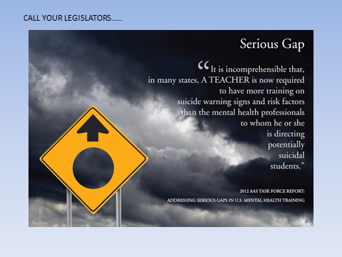

Slide 68
Take Care of Yourself, Working with Suicidal People is Challenging.
♦ Acknowledge the intensity of your feelings.
♦ Seek support.
♦ Avoid over-involvement. It takes a team of people to help a suicidal individual.
♦ Never do this work on your own. Always inform your supervisor or other designated person as outlined in school protocol.
Recognize that you are not responsible for another person’s choice to end his/her life.

Slide 69
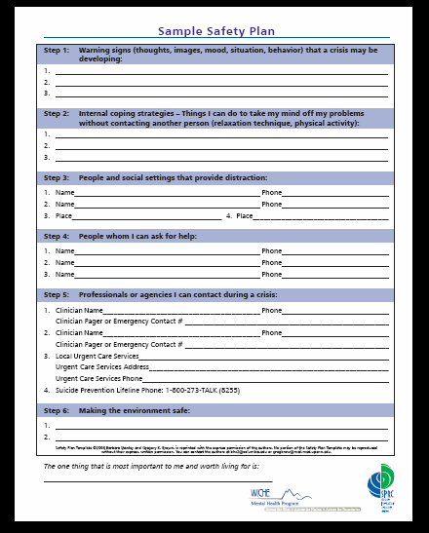
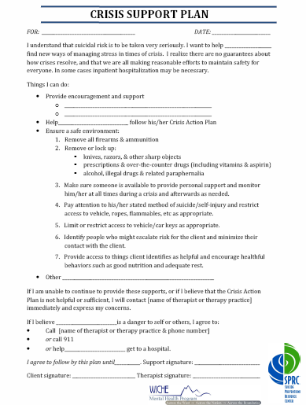
Tools

Slide 70
Know Your Local Resources
Counseling Centers- What happens there?
Give a resource sheet to parents/guardians. Give information on lethal means and try to negotiate an agreement. (Counseling on Lethal Means- SPRC)
- What Every Parent Should Know Video (Society for the Prevention of Teen Suicides)
- National Suicide Hotline Card, Trevor Hot Line Card
- Safety Plan for School and another one for Home
- Sponsor a Parent Information Night or include Suicide Prevention in ALL parent information handouts
Have resources for kids in a easy access spot at school WHERE THEY DON’T HAVE TO ASK!

Slide 71
Free Resources and Tools
Safety plans - SPRC website templates
Free resources at Substance Abuse and Mental Health Service Administration SAMHSA Publications
Counseling for Lethal Means (CALM)- SPRC
National Suicide LifeLine: 24/7 1-800-273-8255(TALK)
Trevor Project for Lesbian, Gay, Bisexual and
Transgender HOTLINE 24/7: 1-866-488-7386
Jed Foundation – College age http://www.jedfoundation.org/
Wellaware on-line trainings (excellent)
Working Minds Managing Suicide Prevention in the Workplace
Suicide Prevention app for phones = SAMHSA

Slide 72


