Slide 1
Gatekeepers Training for Youth Suicide
Notes:
MYSPP Awareness Presentation
1

Slide 2
According to the Surgeon General’s
National Strategy for Suicide Prevention
A gatekeeper is someone in a position to recognize a crisis and the warning signs that someone may be contemplating suicide.
Gatekeepers include parents, friends, neighbors, teachers, ministers, doctors, nurses, office supervisors, squad leaders, foremen, police officers, advisors, caseworkers, firefighters, and many others who are strategically positioned to recognize and refer someone at risk of suicide.
A Gatekeeper refers to someone who:
Knows basic information about suicide and learns basic suicide intervention skills.
Believes that suicide can be prevented.
Has the confidence to respond.
Can assist in the aftermath of a suicide.

Slide 3
Today We Will Cover
Facts about suicide – What it is and what it isn’t
Understanding risk and protective factors, warning signs, and triggers
Increased risk factors for different populations
Basic intervention skills to use with suicidal youth and intervention with parents/guardians

Slide 4
Attitude
Please come into this training with an understanding that you are not asked to be a therapist!
This training is similar to any training for identifying the signs of a physical illness and asking for help for a child.
Yes, suicide is scary. We are only asking you to do what you would normally want to do anyway, we are just giving you some tools.

Slide 5
A Comprehensive Suicide Prevention Program
1. Schools should have protocols in place PRIOR to any trainings on how to identify students at risk of suicide. Everyone in the school should know these protocols.
Identifying students who may be at risk of suicide will be more likely to be successful when these procedures are in place, and only after these procedures are in place is a school ready to implement other suicide prevention strategies.
2. Staff Training
3. Student Training
4. Parent/guardian Training

Slide 6
Language
MUST Avoid:
“successful suicide”
“failed attempt”
Please USE:
“suicide” or “died by/of suicide”
“non-fatal attempt”
Should Avoid:
“committed suicide”
“completed suicide”
“JUST a cry for help”
Please USE:
“died by/of suicide”
“a suicide attempt”
Notes:
6

Slide 7
Language
Ideation - Thoughts, talk, sharing of plans that may indicate a person is thinking about taking his/her own life.
Attempt: A self-inflicted, potentially injurious behavior with a nonfatal outcome for which there is evidence of intent to die.
Suicide: A self-inflicted death with evidence (implicit or explicit) of the intent to die.
Self-Injury: Not ‘cutting’. Self-inflicted physical harming behaviors (can be burns, bruises, etc.) that happen without the intent to die.

Slide 8
You are all Gatekeepers!

Slide 9
All staff should have:
Education on the importance of suicide prevention and….
How to recognize suicide risk and How to refer someone
for help.
Only selected staff will have:
Specific training to assess the lethality of a suicidal thought/behavior.
You are not alone in this!

Slide 10
TEAM for School Suicide Prevention
Guidance Counselor
Faculty and Staff
Parents
Guardians
School Administration
Mental Health
Provider
Emergency
Services

Slide 11
Youth suicide prevention in schools includes five major areas of responsibility:
1. Identification- everyone;
2. Assessment resource of a qualified professional;
3. Management and Referral;
4. Support Services and Monitoring; and
5. Crisis Intervention and Postvention Planning.

Slide 12
Identifying Depression
Identified by observing Feelings-
Sadness and hopelessness lasting more than 2 weeks
Very irritable
Overreacting
Feeling worthless
Anxious
Concerned with physical problems
Fatigued

Slide 13
Depression
Declining performance
Losing interest in things once enjoyed
Experiencing unexplained changes in sleeping or eating patterns
Isolating
Feeling life is too hard to handle
Poor concentration
Racing thoughts

Slide 14
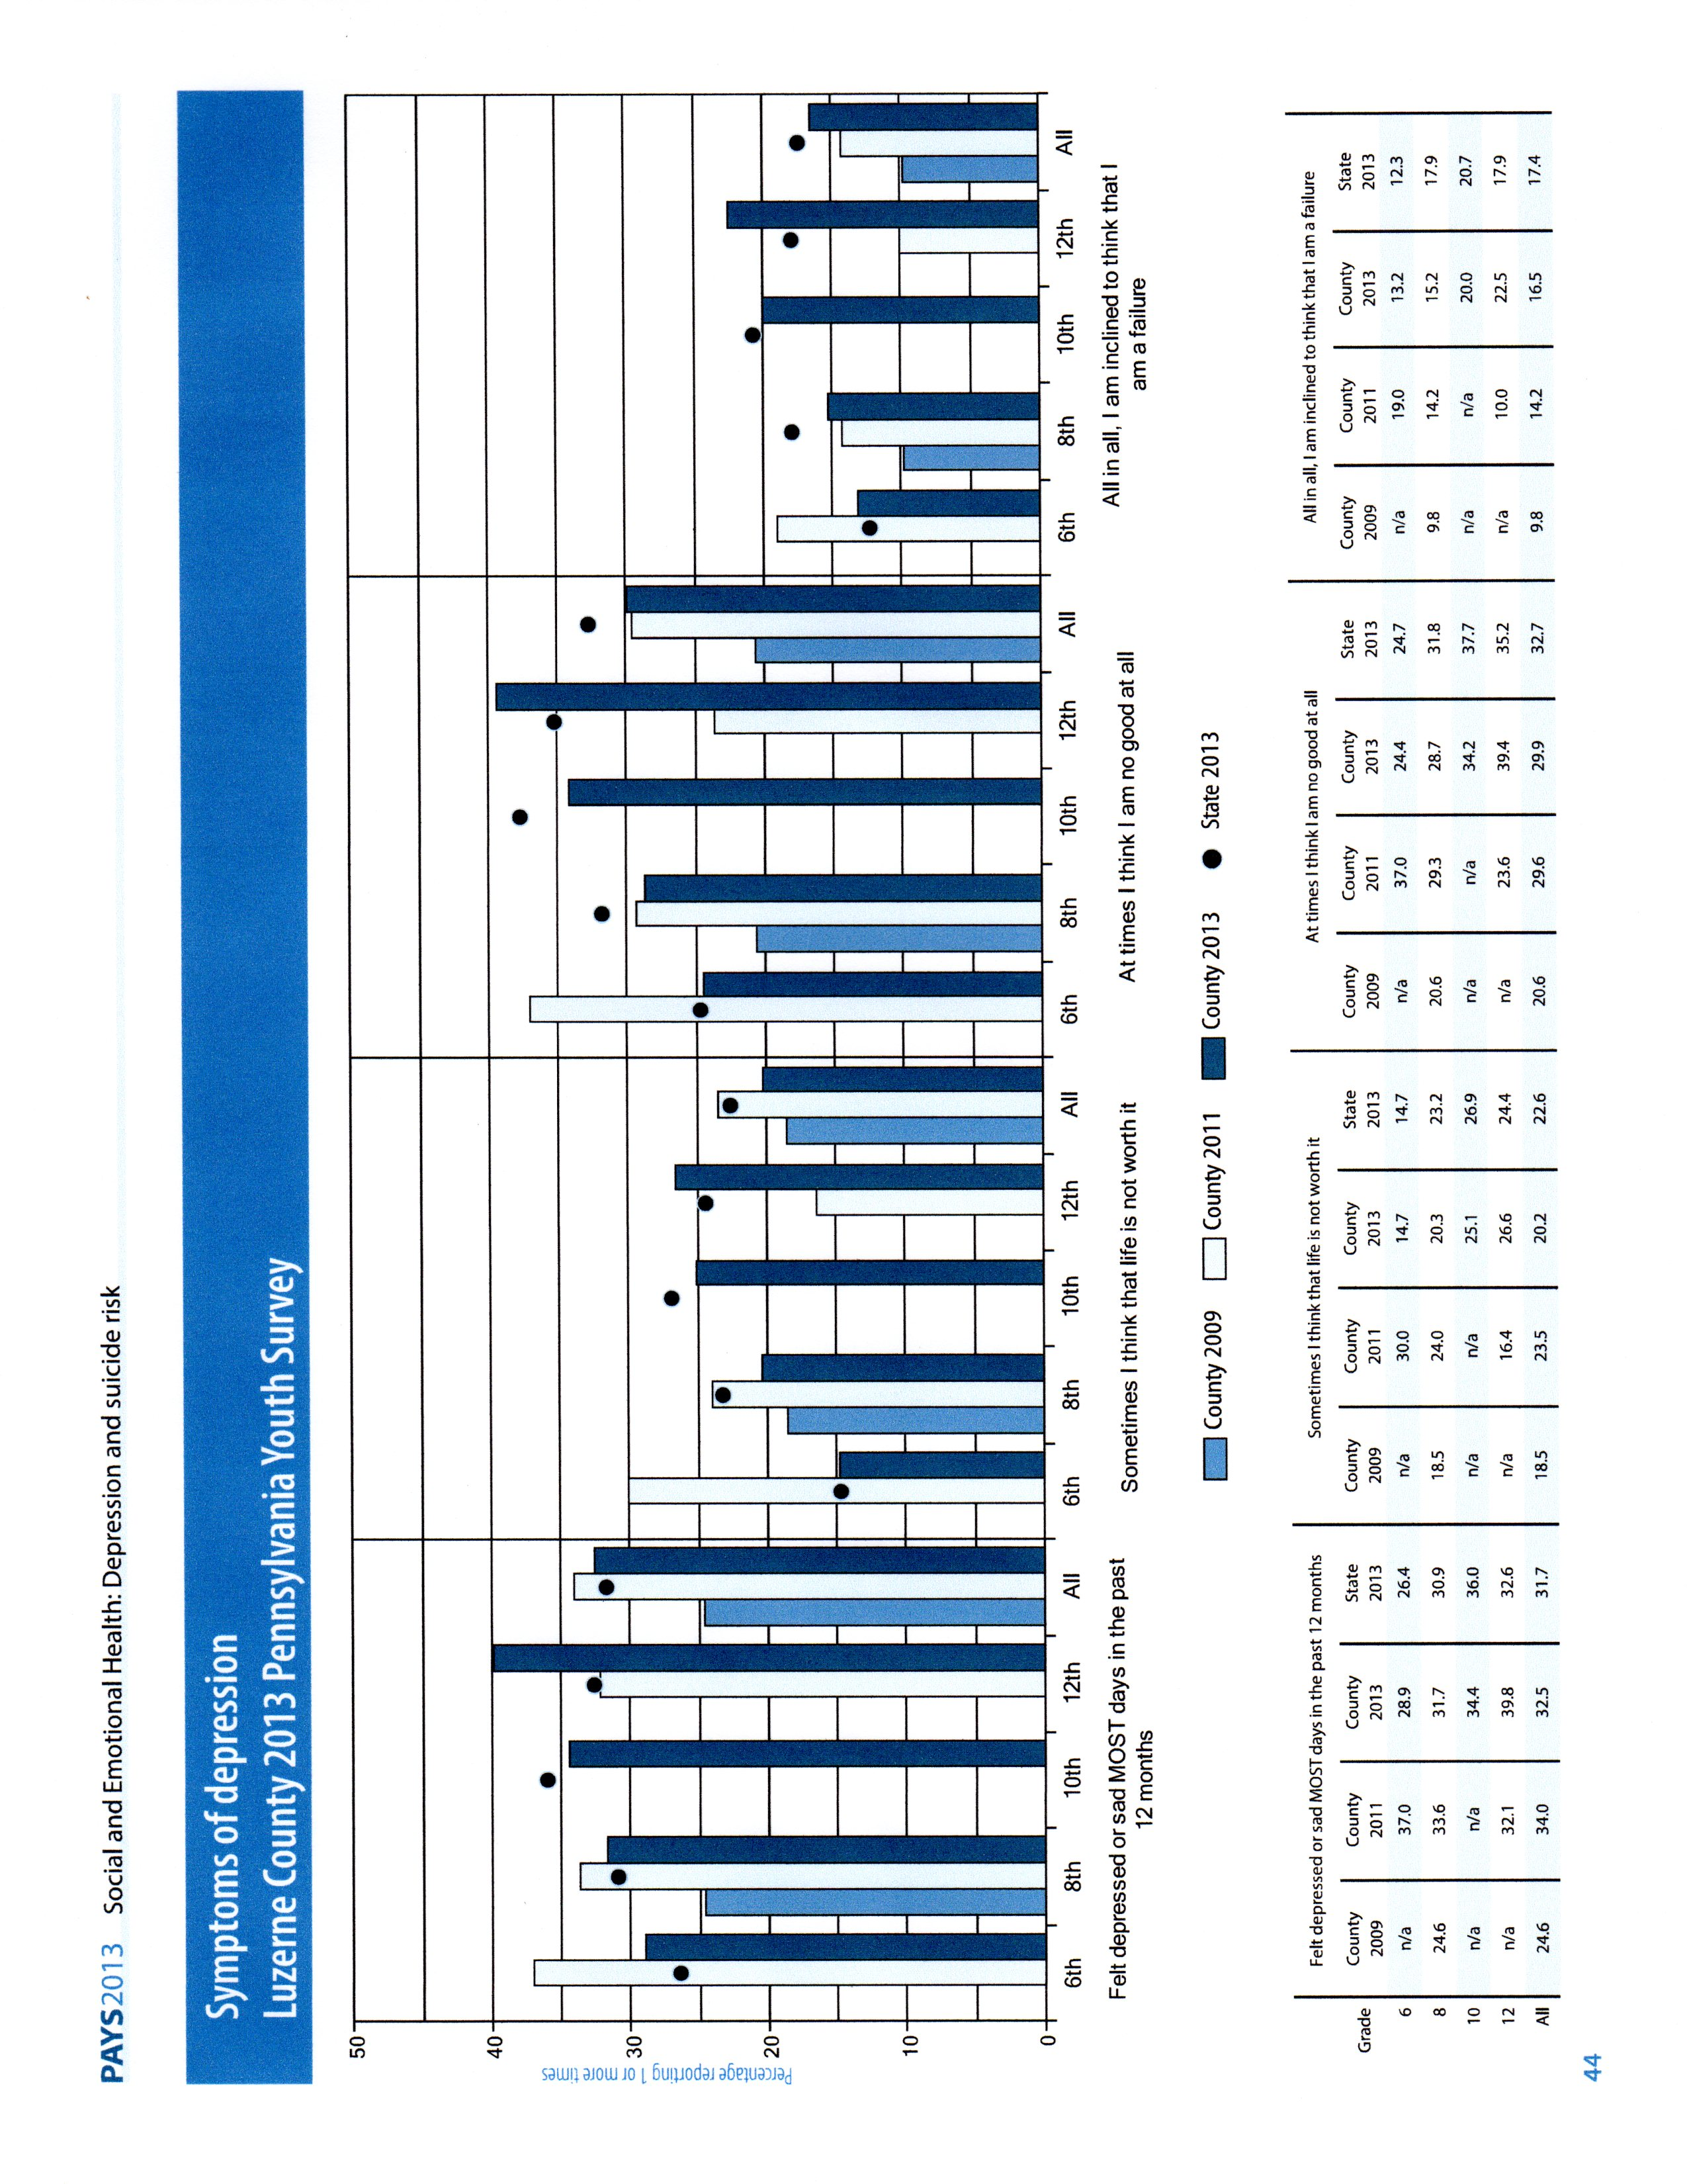

Slide 15
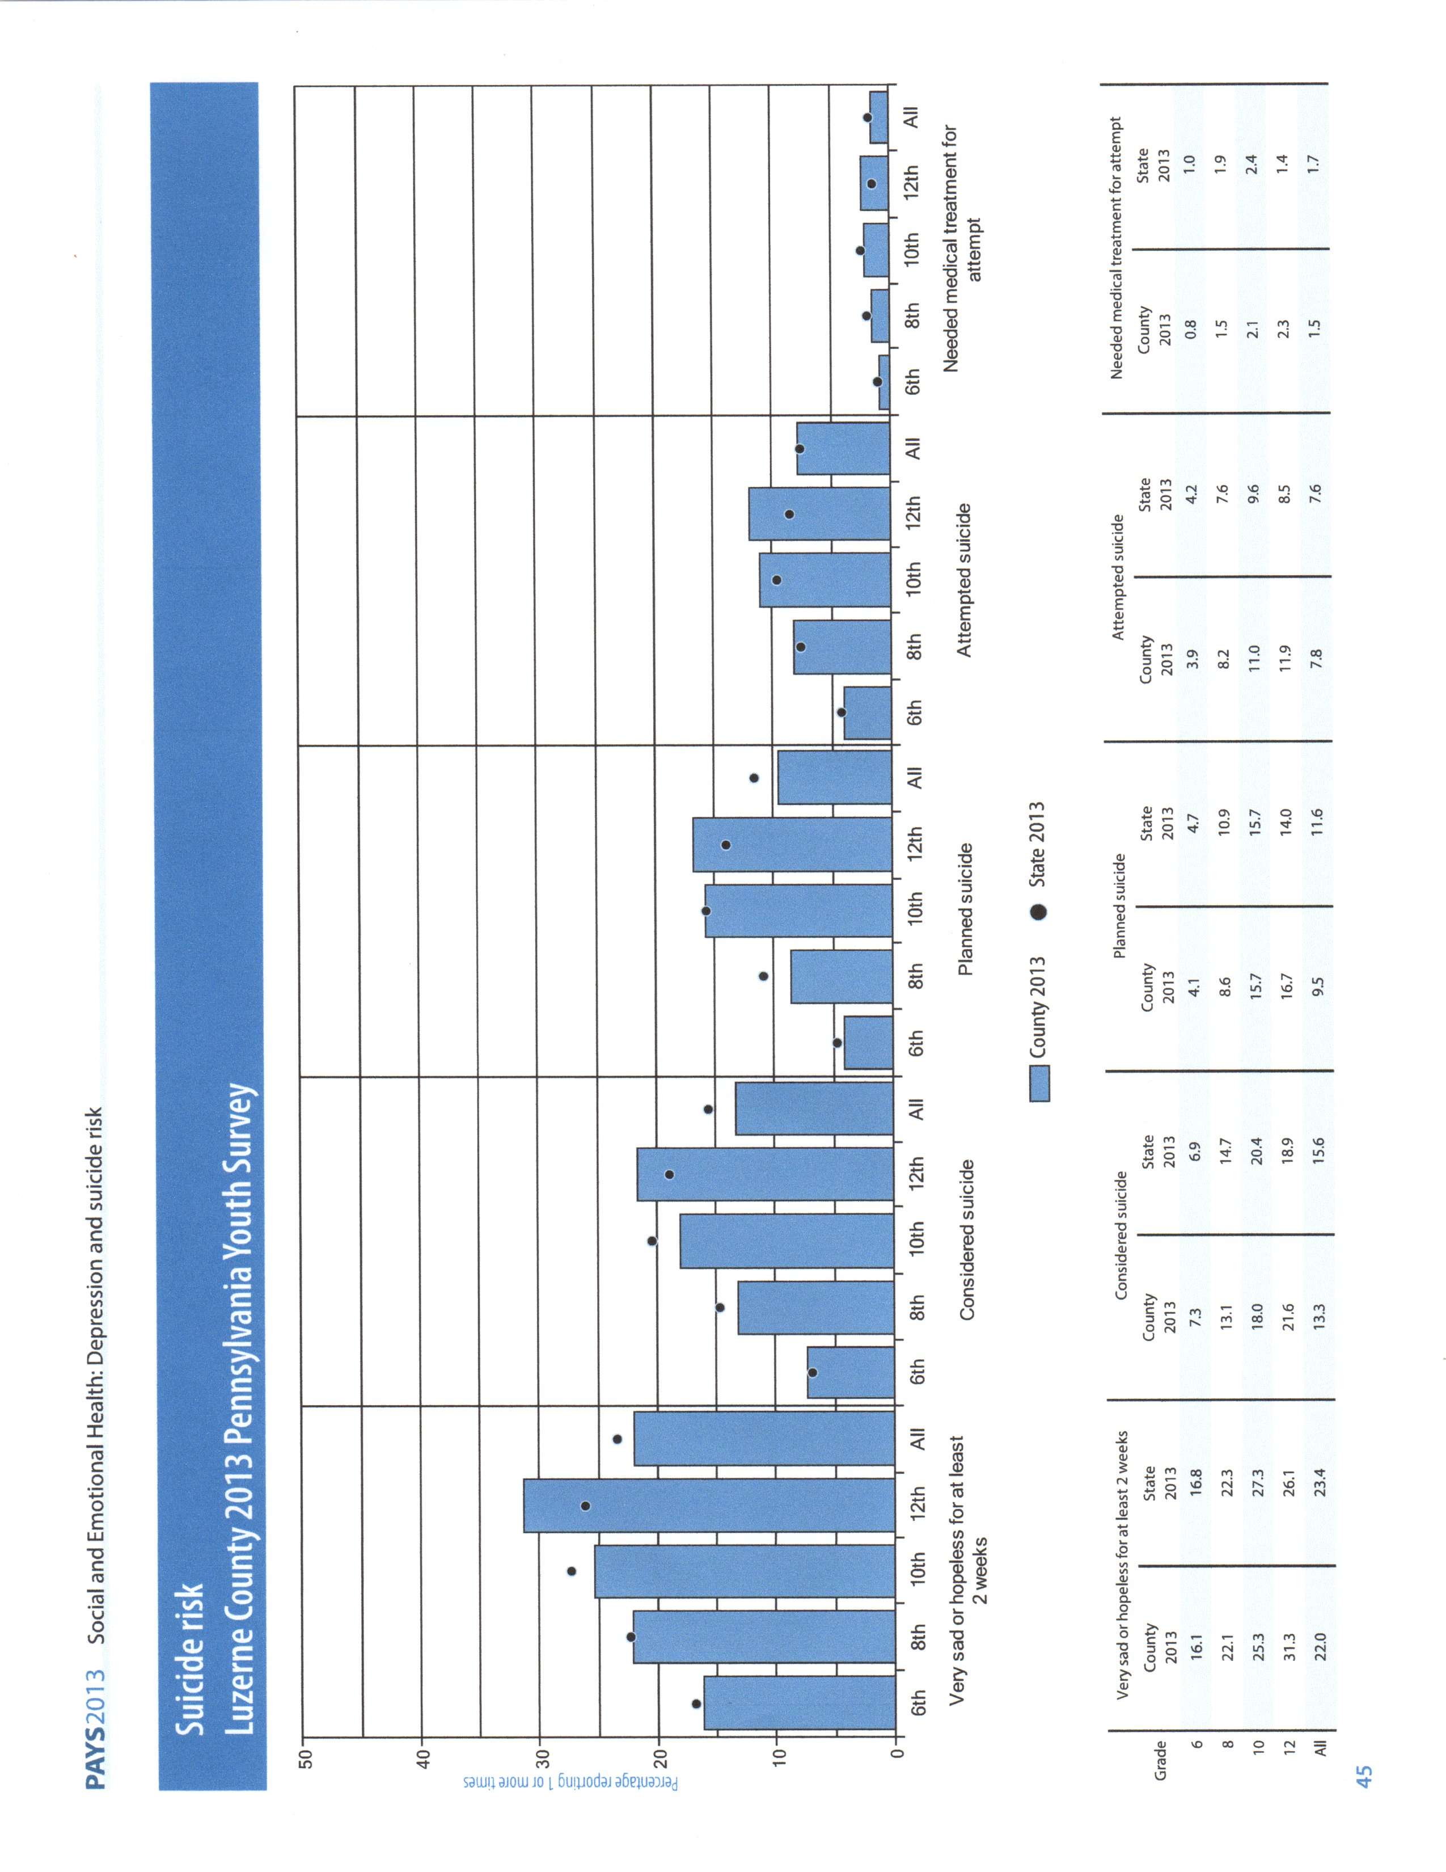

Slide 17
National Estimated Statistics
For every 2 homicide deaths, there are 3 deaths by suicide
Untreated depression is the number one risk factor for suicide in 15-24 year olds
Suicide is the 3rd 2nd leading cause of death (15- 24)
Young males age 15 to 24 are at highest risk for suicide, with a ratio of males to females at 7:1

Slide 18
In the typical high school classroom:
1 male and 2 females have probably attempted suicide in the past year
Notes:
18

Slide 19
Difficulty with Statistics
It is difficult to compile accurate statistics on suicide, since many deaths that are suicides are ruled to be accidental. Overdoses & car accidents are 2 examples.
With a clearer understanding of violent deaths we can guide local decisions about efforts to prevent suicides.
Is there a time of year that show increased deaths, are there specific ages more at risk, or will the means used help focus attention and resources?

Slide 20
Risk Factors- Protective Factors But Most Important are Warning Signs
Risk factors are characteristics that make it more likely that an individual will consider, attempt, or die by suicide.
Protective factors are characteristics that make it less likely that individuals will consider, attempt, or die by suicide.
Warning Signs: Behaviors that can be observed (Aggression, Sadness, Drug or Alcohol Abuse) and are more serious than risk.

Slide 21
Risk Factors
Risk factors are stressful events, situations, or conditions that exist in a person’s life that may increase the likelihood of attempting or dying by suicide. They can be biological (genetics), community (high crime area, overcrowded schools), psychological (early trauma).
There is no predictive list of a particular set of risk factors that spells imminent danger of suicide. It is important to understand that risk factors DO NOT cause suicide.

Slide 22
Risk Factors for Adolescent Suicide
Depression, anxiety, or mood disorder
Current or previous suicidal behavior
Being a victim of sexual or emotional abuse
Conduct problems
Access to lethal means
Notes:
MYSPP Awareness Presentation
22

Slide 23
LGBT Issues
Suicide is the 3^{rd,} 2nd leading cause of death among 15 to 24 year olds. Now from 12 years of age to 24!
LGBTQ youth are up to 4x more likely to attempt suicide than their heterosexual peers because of the ways they are treated in their homes, schools, and various communities
Sources: CDC 2007; Massachusetts Youth Risk Behavior Survey 2009
LGB youth who come from highly rejecting families are more than 8 times as likely to have attempted suicide than LGB peers who reported no or low levels of family rejection
More than 75% LGBTQ youth report verbal abuse while 15% report physical abuse at school. More than 1/3 will lose friends through coming out. Increased victimization and losing friends both predict negative mental health outcomes—including substance use and suicide

Slide 24
Substance Abuse & Suicide
Suicide is the leading cause of death among people who abuse alcohol and drugs? (Wilcox, Conner, and Caine 2004)
Individuals who are treated for alcohol abuse or dependence are at about 10 times greater risk to eventually die by suicide compared to the general population, and people who inject drugs are at about 14 Xs greater risk for eventual suicide?
People in treatment are at elevated risk for many reasons, including:
- They enter treatment when they are at a point where their substance abuse is out of control, increasing a variety of risk factors for suicide;
- Mental Health problems(e.g., depression, Post traumatic stress disorder, anxiety disorders, some personality disorders) associated with suicide often co-occur among people who have been treated for substance abuse.
- Crisis that are known to increase suicide risk sometimes occur during treatment (e.g., relapses).

Slide 25
Protective Factors
Protective Factors - personal and social resources that promote resiliency and reduce the potential of suicide. Characteristics that make it less likely that individuals will consider, attempt, or die by suicide. Protective factors may be family level (close supportive family), community level (small classrooms, positive supportive teachers), social (youth activities).
Many protective factors can be increased and some risk factors can be decreased.

Slide 26
Protective Factors
Supports - Supportive parents, friends, teachers & other caring adults
Skills to think, communicate, solve problems, manage anger
Purpose & value in life-hope for future
Personal characteristics - good health, positive outlook, healthy choices
Safe Environment – restricted access to lethal means

Slide 27
A Word About Young Children
SOME young children (ages 5-14) do understand the concept of death, are capable of planning a suicide and able to implement the plan.
It is a rare event, but we must not assume that children can not or do not die by suicide. They do!
Some states have documented suicides in children as young as 8 years old.
Notes:
more than sad video
more than sad video

Slide 28
Warning Signs
The earliest signs that indicate the risk of suicide for an individual in the near-term (within minutes, hours or days.)
Warning signs are indications that someone MAY be in danger of suicide.
Warning signs can be identified!
Notes:
28

Slide 29
Early Warning Signs of Suicide
Includes Behavioral, Emotional & Physical Signs:
Depressed / Anxious
Increased alcohol/drug use
“Roller coaster” moodiness
Changes in every day behaviors
Overly pessimistic, hopeless
Neglects self, friends, usual activities
Notes:
29

Slide 30
Late Warning Signs/Behaviors May Include:
Talks of suicide, plans for how/when/where
Refuses help
Agitated, restless, picks fights
Gives away favorite things, writes a will
Shows SUDDEN improvement in mood (suicide euphoria)
Increased isolation
Uses instant messaging or phone to drop hints
Notes:
30

Slide 31
Myths
Suicidal people are intent on dying. On the bridge, Baldwin counted to ten and stayed frozen. He counted to ten again, then vaulted over. “I still see my hands coming off the railing,” he said. As he crossed to chord in flight, Baldwin recalls, “I instantly realized that everything in my life that I’d thought was unfixable was totally fixable – except for having just jumped.” (Friend, T. (2003). Jumpers. The New Yorker.)
Improvement after an attempt means the risk is over.

Slide 32
True or False Myths or Facts ?
T or F People who talk about suicide do not actually die by suicide.
T or F Suicide usually happens without warning signs.
T or F Talking or asking someone about suicide may plant the idea and cause a suicide.
T of F Talking about suicide can save lives.
Notes:
32

Slide 33
Triggers - IMPORTANT
If someone has been depressed or thinking about suicide, a trigger can push that person into an suicide attempt or death.
Teachers in schools can be aware of someone who may be feeling bad and/or experienced WHAT THE STUDENT PERCEIVES as a tragic event.
The break up of a close personal relationship, losing old friends, or interpersonal conflicts Something "embarrassing" happens
Loss of self-esteem (e.g., failing at school, being cut from a team) or feeling humiliated Failing an important exam at school Being Bullied Rejection (e.g., not be accepted to a college or graduate school, etc.) Facing arrest, or other legal difficult
Relapse of substance use after a period of recovery

Slide 34
From a Suicidal Person’s Point of View
Crisis point has been reached
Distress/torment/anxiety seems unbearable
Solutions to problems seem unavailable
Rational Thinking is affected
Ambivalence exists between wanting to live and wanting to end the psychological pain
Need to communicate pain is intense!
Notes:
34

Slide 35
Listen for Verbal Clues
Direct
I wish I were dead
I’m going to end it all
Indirect
I’m tired of it all
You’ll be better off without me
What’s the point of living?
Notes:
35

Slide 36
Invitations to Help
FEELINGS
THOUGHTS
Desperate
Angry
Guilty
“All of my problems will end soon”
“No one can do anything to help me now”
“I wish I were dead”
“Everyone will be better off without me”
“I won’t be needing these things anymore”
“I can’t do anything right”
“I can’t think straight”
Worthless Lonely
Sad
Hopeless Helpless
ACTIONS
Giving away possessions
Withdrawal (family, friends, school, work)
Loss of interest in hobbies
Abuse/use of alcohol, substances
Reckless behavior
Extreme mood swings
PHYSICAL
Lack of interest in appearance
Changes in appetite, weight
Change in sleep patterns
Notes:
36

Slide 37
Intervention--Why People Hesitate
Inability/lack of knowledge
Worry about doing/saying the “right” thing
Feelings of inadequacy
Belief in myths of suicide
Notes:
37

Slide 38
What is NOT Helpful
Ignoring or dismissing the issue
Acting shocked or embarrassed
Challenging, debating or bargaining
Giving harmful advice
Notes:
38

Slide 39
What IS Helpful
Show You Care—Listen carefully—Be genuine “I’m concerned about you . . . about how you feel.”
Ask the Question—Be direct, caring and non-confrontational “Are Are you thinking about suicide?”
Get Help—Do not leave him/her alone
“You’re not alone. Let me help you.”
Notes:
39

Slide 40
What Else Can You Do?
Support family/friends
Acknowledge the impact, the fear
Avoid judging, blaming gossip
Emphasize safety and removal of all lethal means from household
Encourage appropriate help
Notes:
40

Slide 41
How You Can Help After a Suicide
Acknowledge the loss
Share a special memory/story
Use the name of the deceased
Share your presence
Acknowledge the good things
Stay in touch
Call for grief support group information

Slide 42
Resources for Help - Websites
National Suicide Prevention Lifeline
http://www.suicidepreventionlifeline.org/
MYSPP Web Site: www.mainesuicideprevention.org
Online Crisis Chat:
www.crisischat.org or www.arcrisis.org

Slide 43
Want to Learn More?
Free resources at Substance Abuse and Mental Health Service Administration SAMHSA Publications (APP for phones also)
Counseling for Lethal Means (CALM)- SPRC Webinar
National Suicide LifeLine: 24/7 1-800-273-8255(TALK)
Trevor Project for Lesbian, Gay, Bisexual and Transgender
HOTLINE 24/7: 1-866-488-7386
Jed Foundation – College age http://www.jedfoundation.org/
Suicide Prevention Resource Center (SPRC)
www.Action Alliance.org

Slide 44
Our school protocol is…
Notes:
44
Our protocol is…

